Slide 1
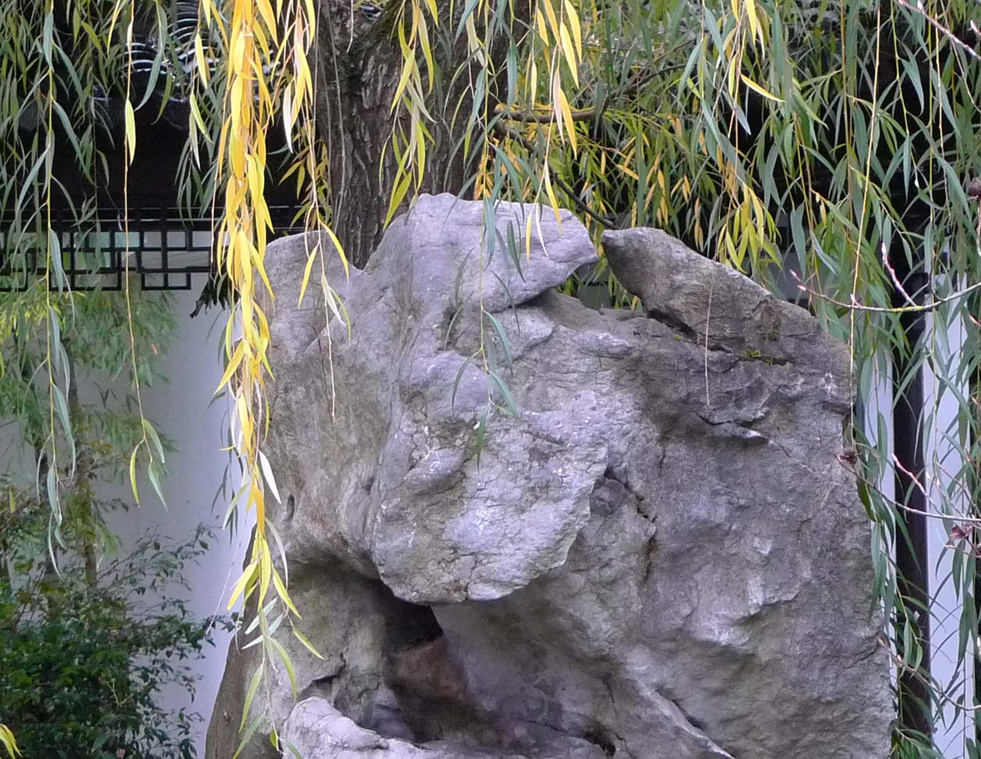
Tom DeFanti
Research Scientist
California Institute for Telecommunications and Information Technology
University of California, San Diego
Distinguished Professor Emeritus of Computer Science
University of Illinois at Chicago
Greener Collaboration: Better than Being There

Slide 2
Rajesh Gupta: “There is a Value in Meeting Together” But, there’s also an Energy Cost!
Tom DeFanti today has saved approximately 50,000,000 BTU of energy by walking to PRAGMA instead of flying from Tokyo to San Diego!
Same as running eight 200-watt servers for an entire year!
An October 15-person videoconference between Chicago, San Diego and colleagues in Saudi Arabia saved the equivalent energy of running all the visualization laboratory displays you’ll see today for 10 hours a day for a year!
Of course, the amount of carbon emission is the measure, not watts, which makes the comparison further favor teleconferencing
And, we really don’t know the energy cost of providing the teleconferencing we are using today
The OptIPuter project had worked hard to make tele-meeting work well.
Project GreenLight is discovering facts about energy consumption in ICT, including servers, displays and networks
All the numbers to be presented today are preliminary results and need further (peer) review!

Slide 3
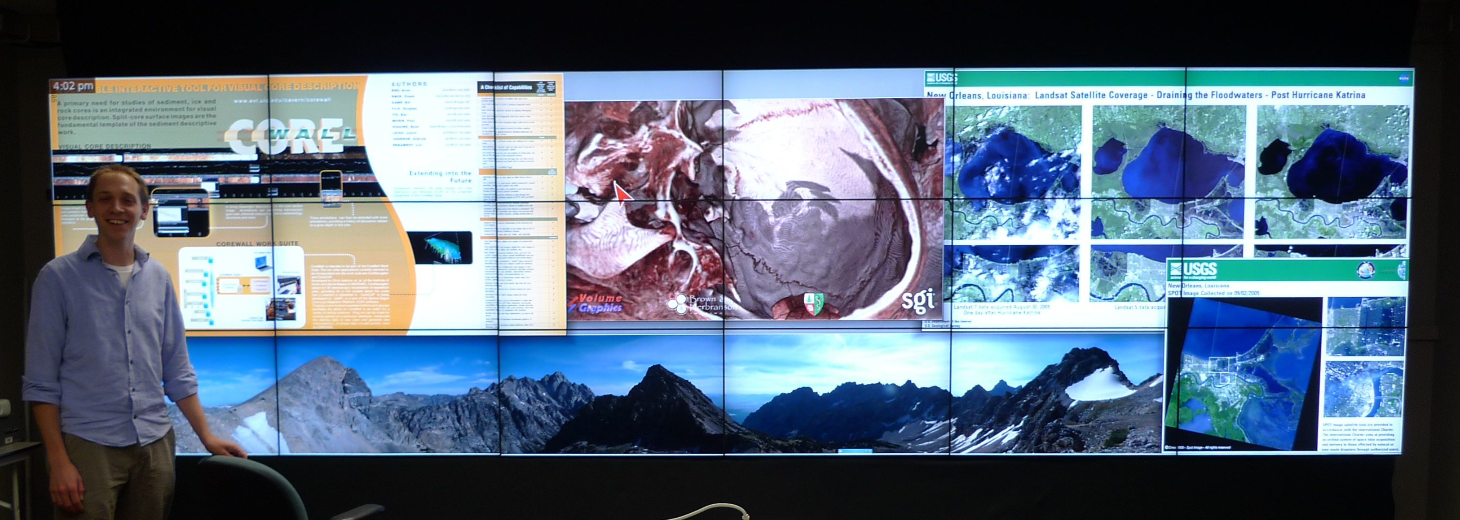
In Summer 2009, Tiled Displays got Really Good!
Electronic Visualization Laboratory, University of Illinois at Chicago
18-tile NEC 46” Ultra Narrow Bezel SAGE display
Bright, Smart, Nearly Seamless, CaliFragilistic
40-tile 46” Diagonal Narrow-Bezel AESOP display at KAUST ~$200K

Slide 4
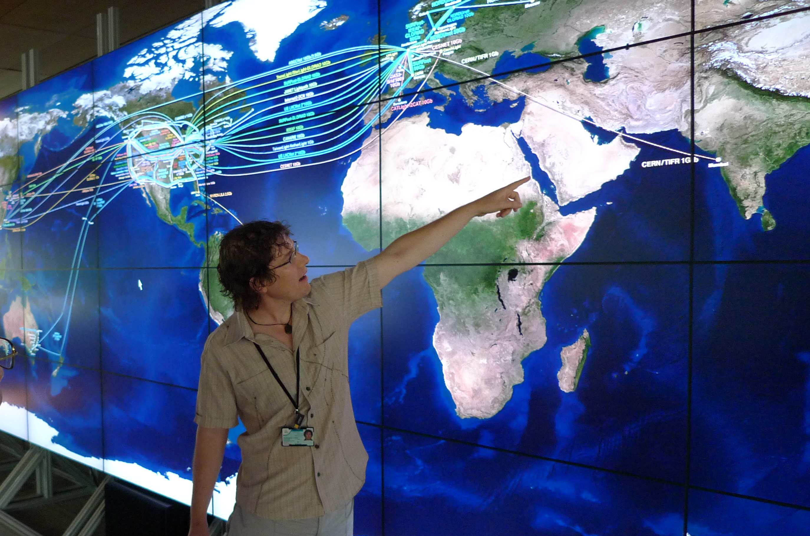
AESOP Display at The King Abdullah University of Science and Technology (KAUST)
40-tile 46” Diagonal Narrow-Bezel AESOP display at KAUST running CGLX

Slide 5
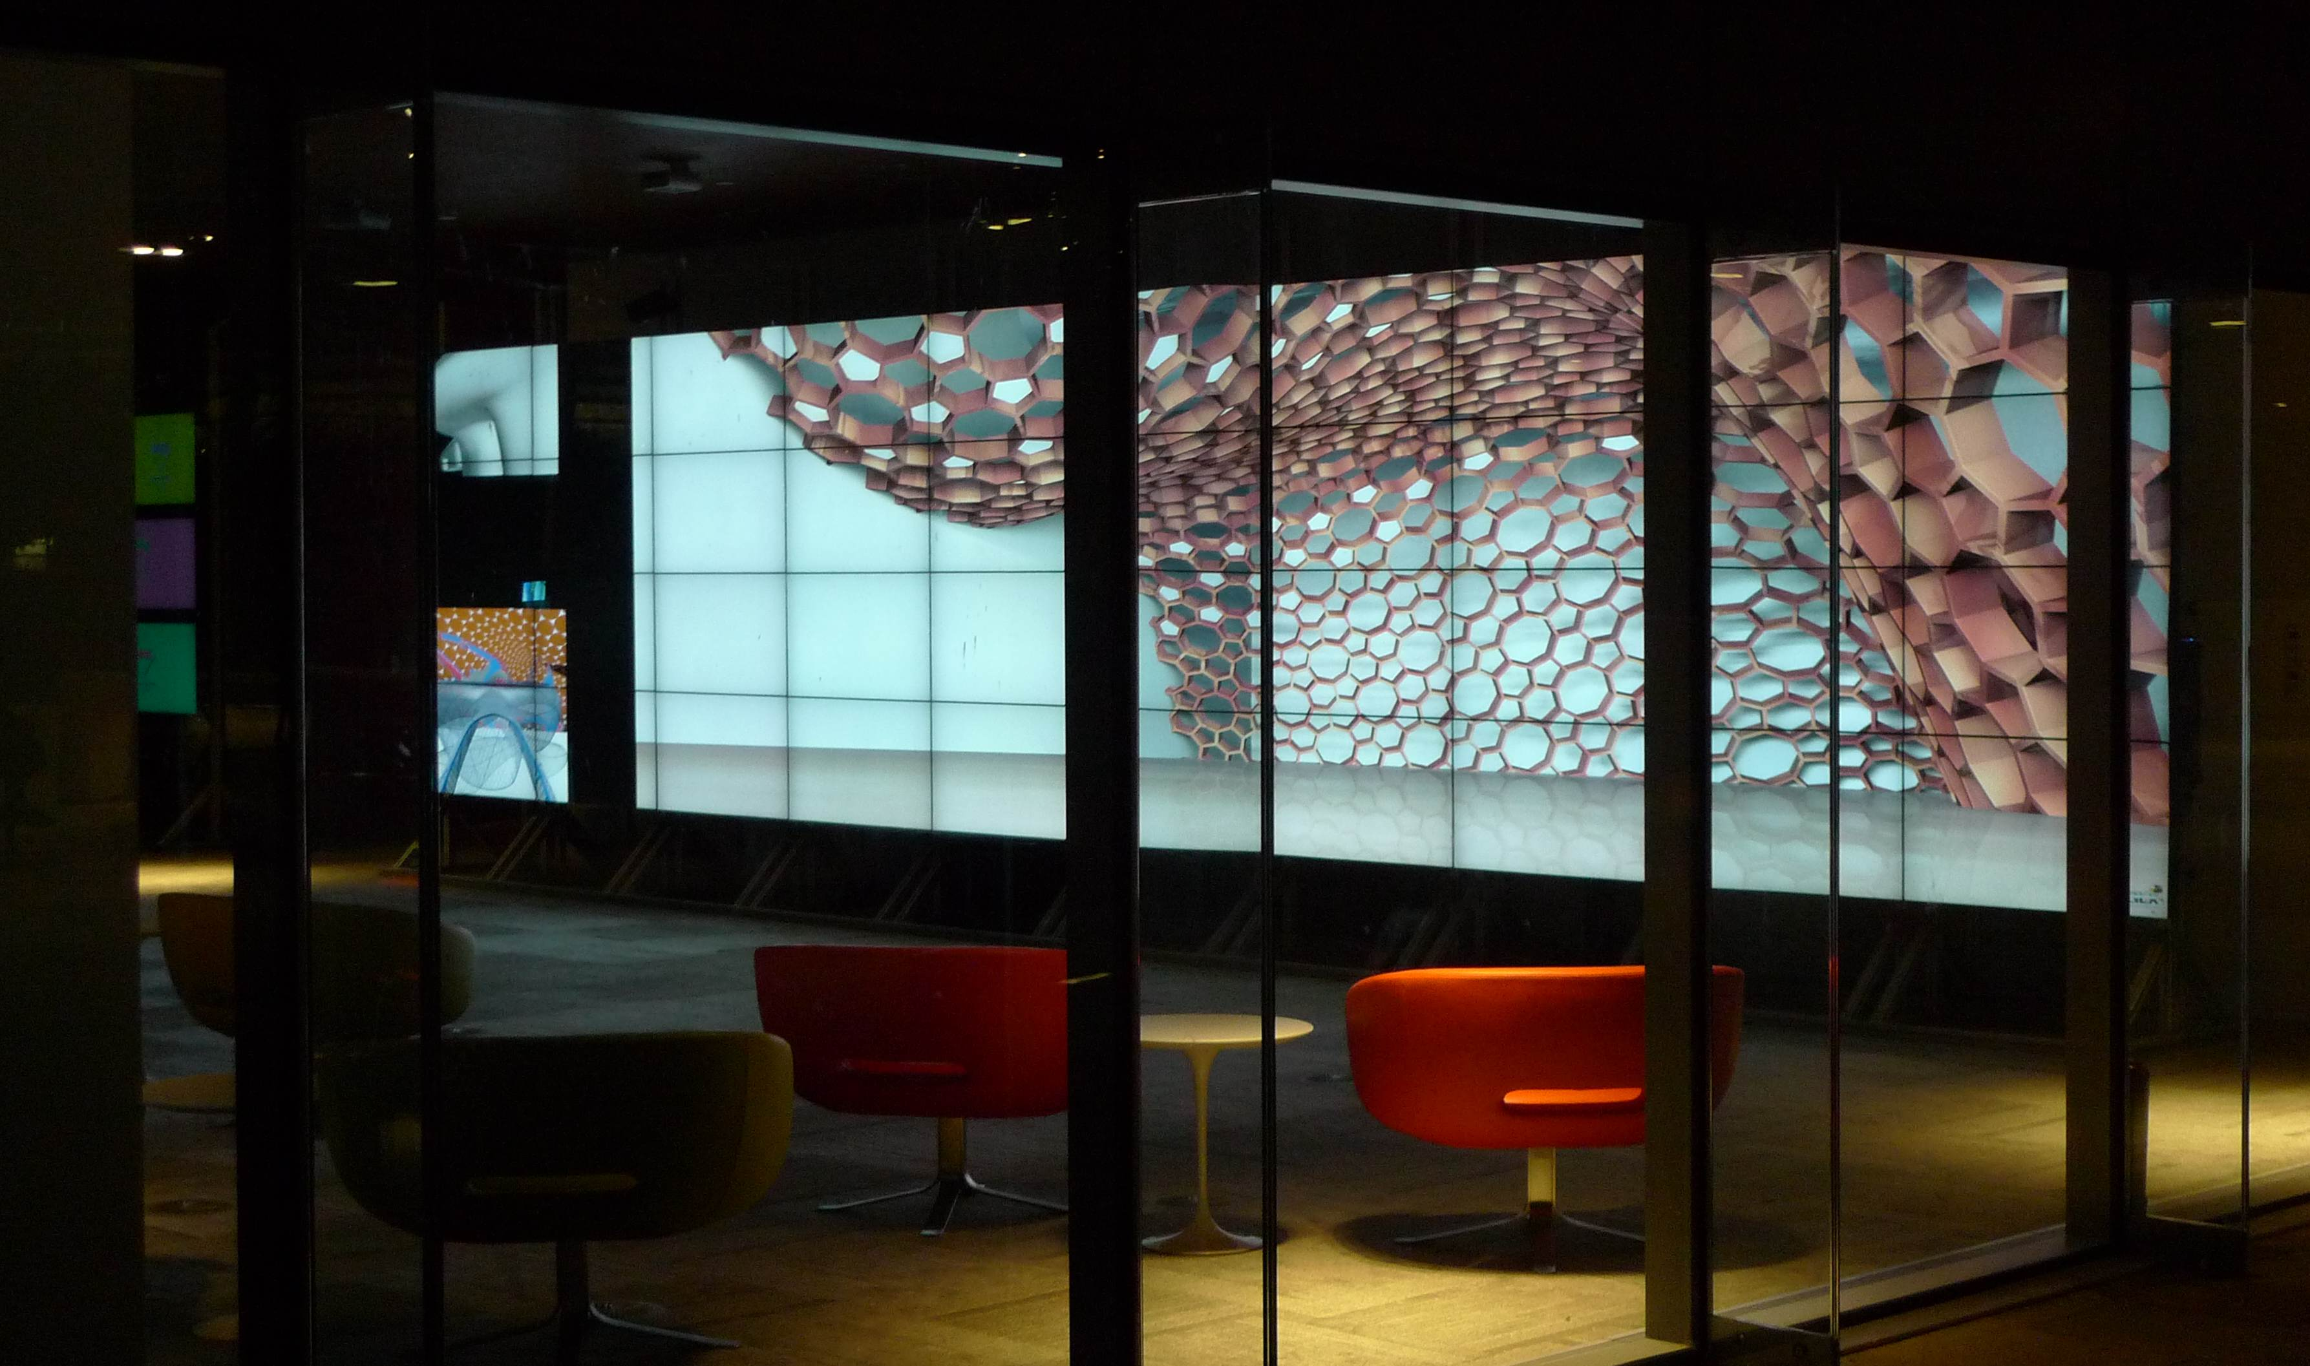
KAUST AESOP Display at Night

Slide 6
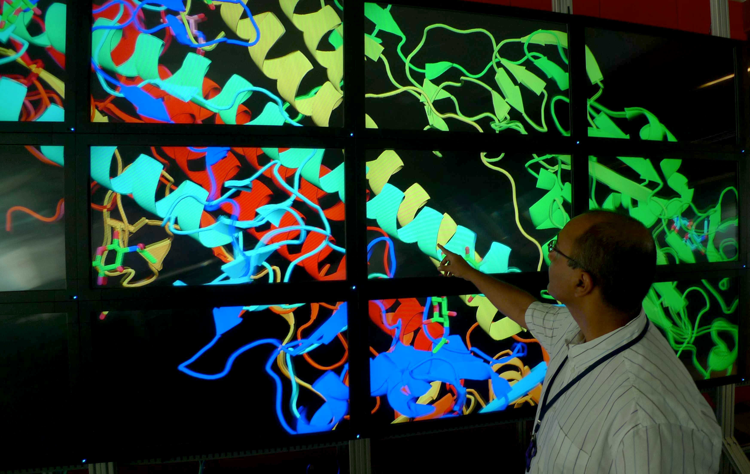
REVE Autostereo Display at KAUST
18-tile 42” Diagonal Alioscopy REVE display at KAUST

Slide 7
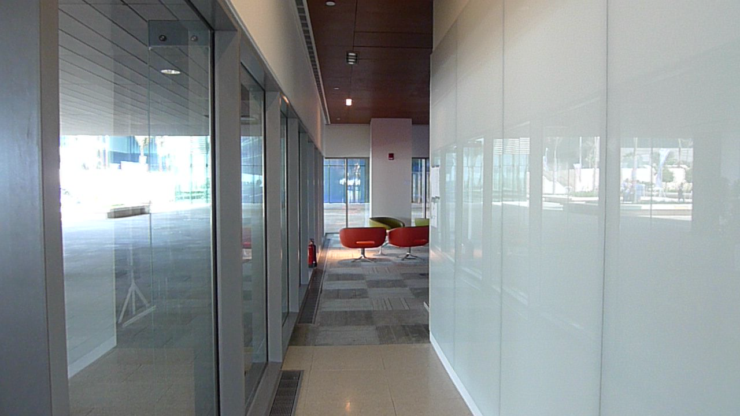
KAUST Showcase from the Inside

Slide 8
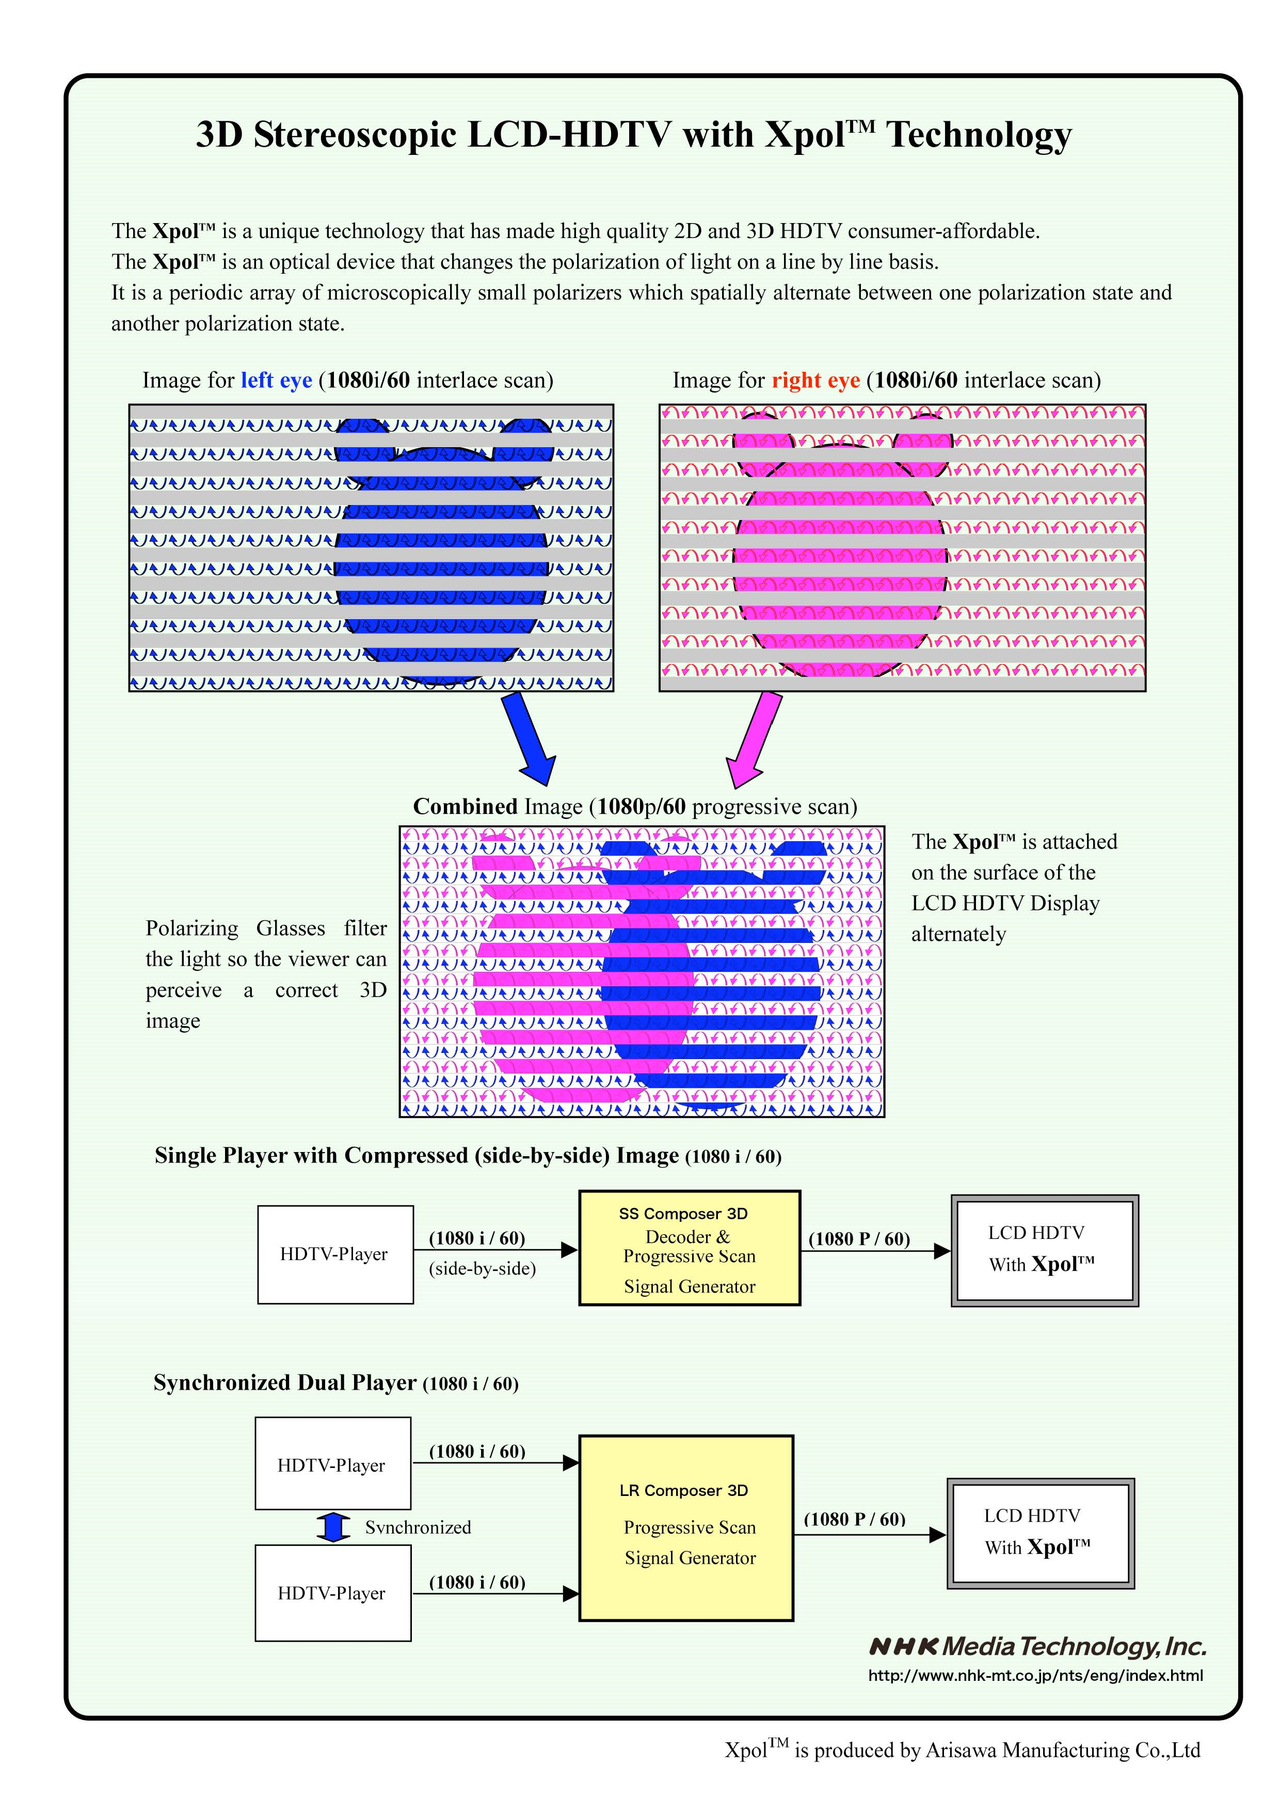
Tiled Micropolarized (Xpol) 3D JVC Panels (w/Glasses)
Source: NHK Media Technology, Inc.

Slide 9
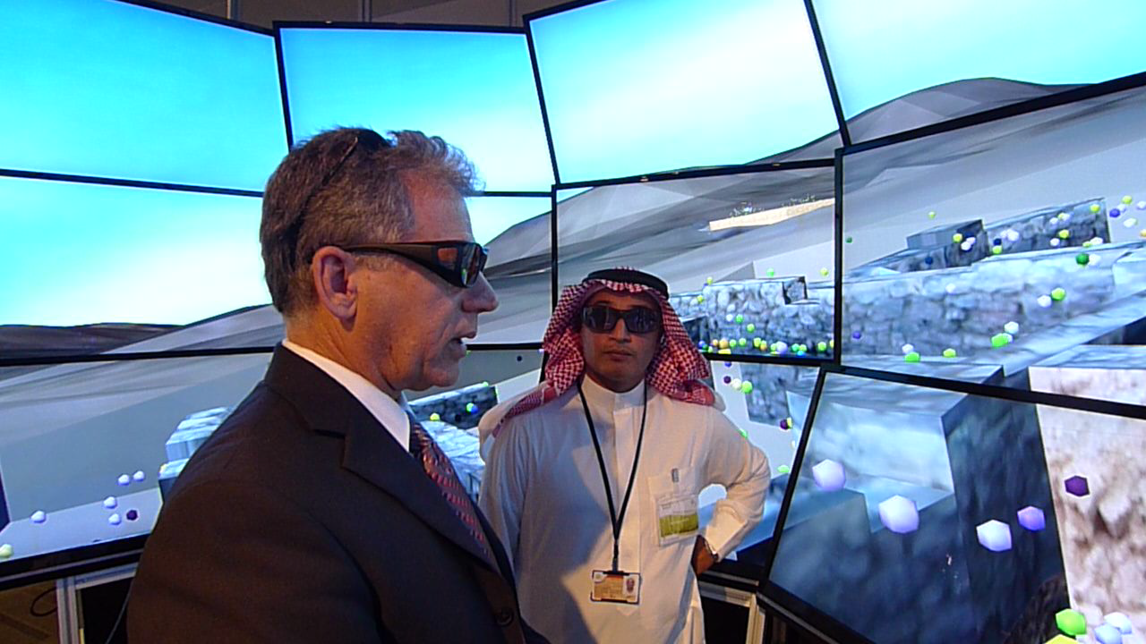
Tom Levy in KAUST’s NexCAVE

Slide 10
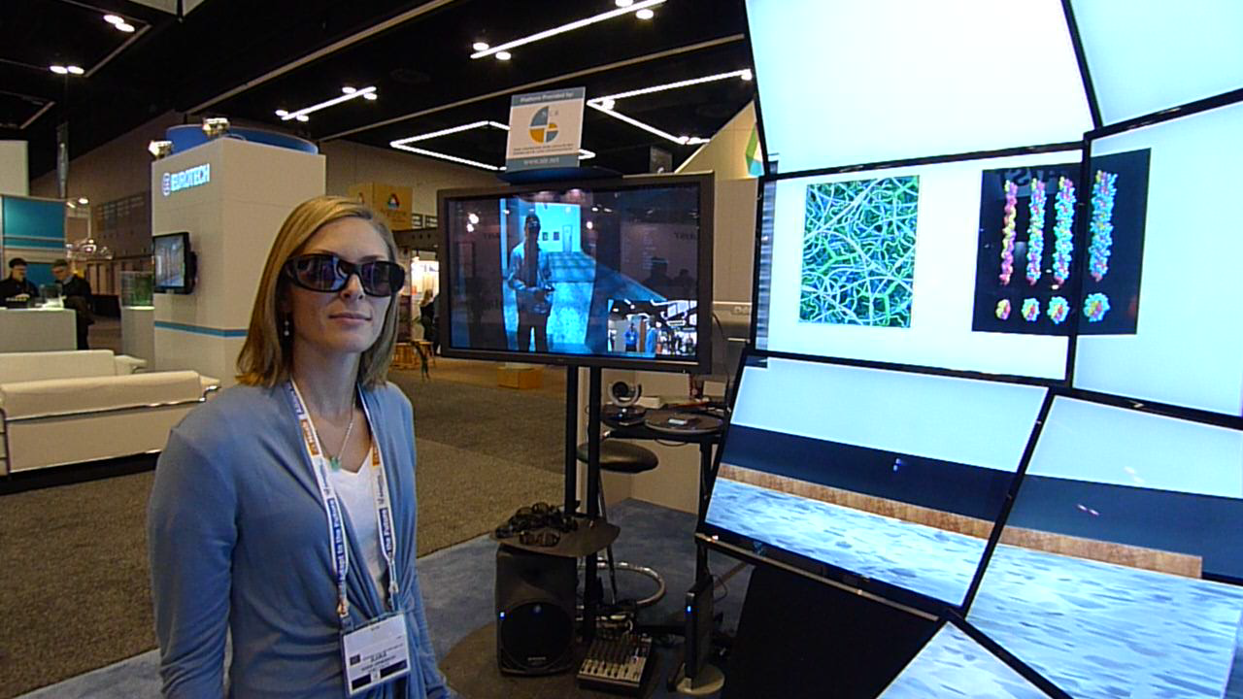
Collaboration in the NexCAVE/StarCAVE

Slide 11
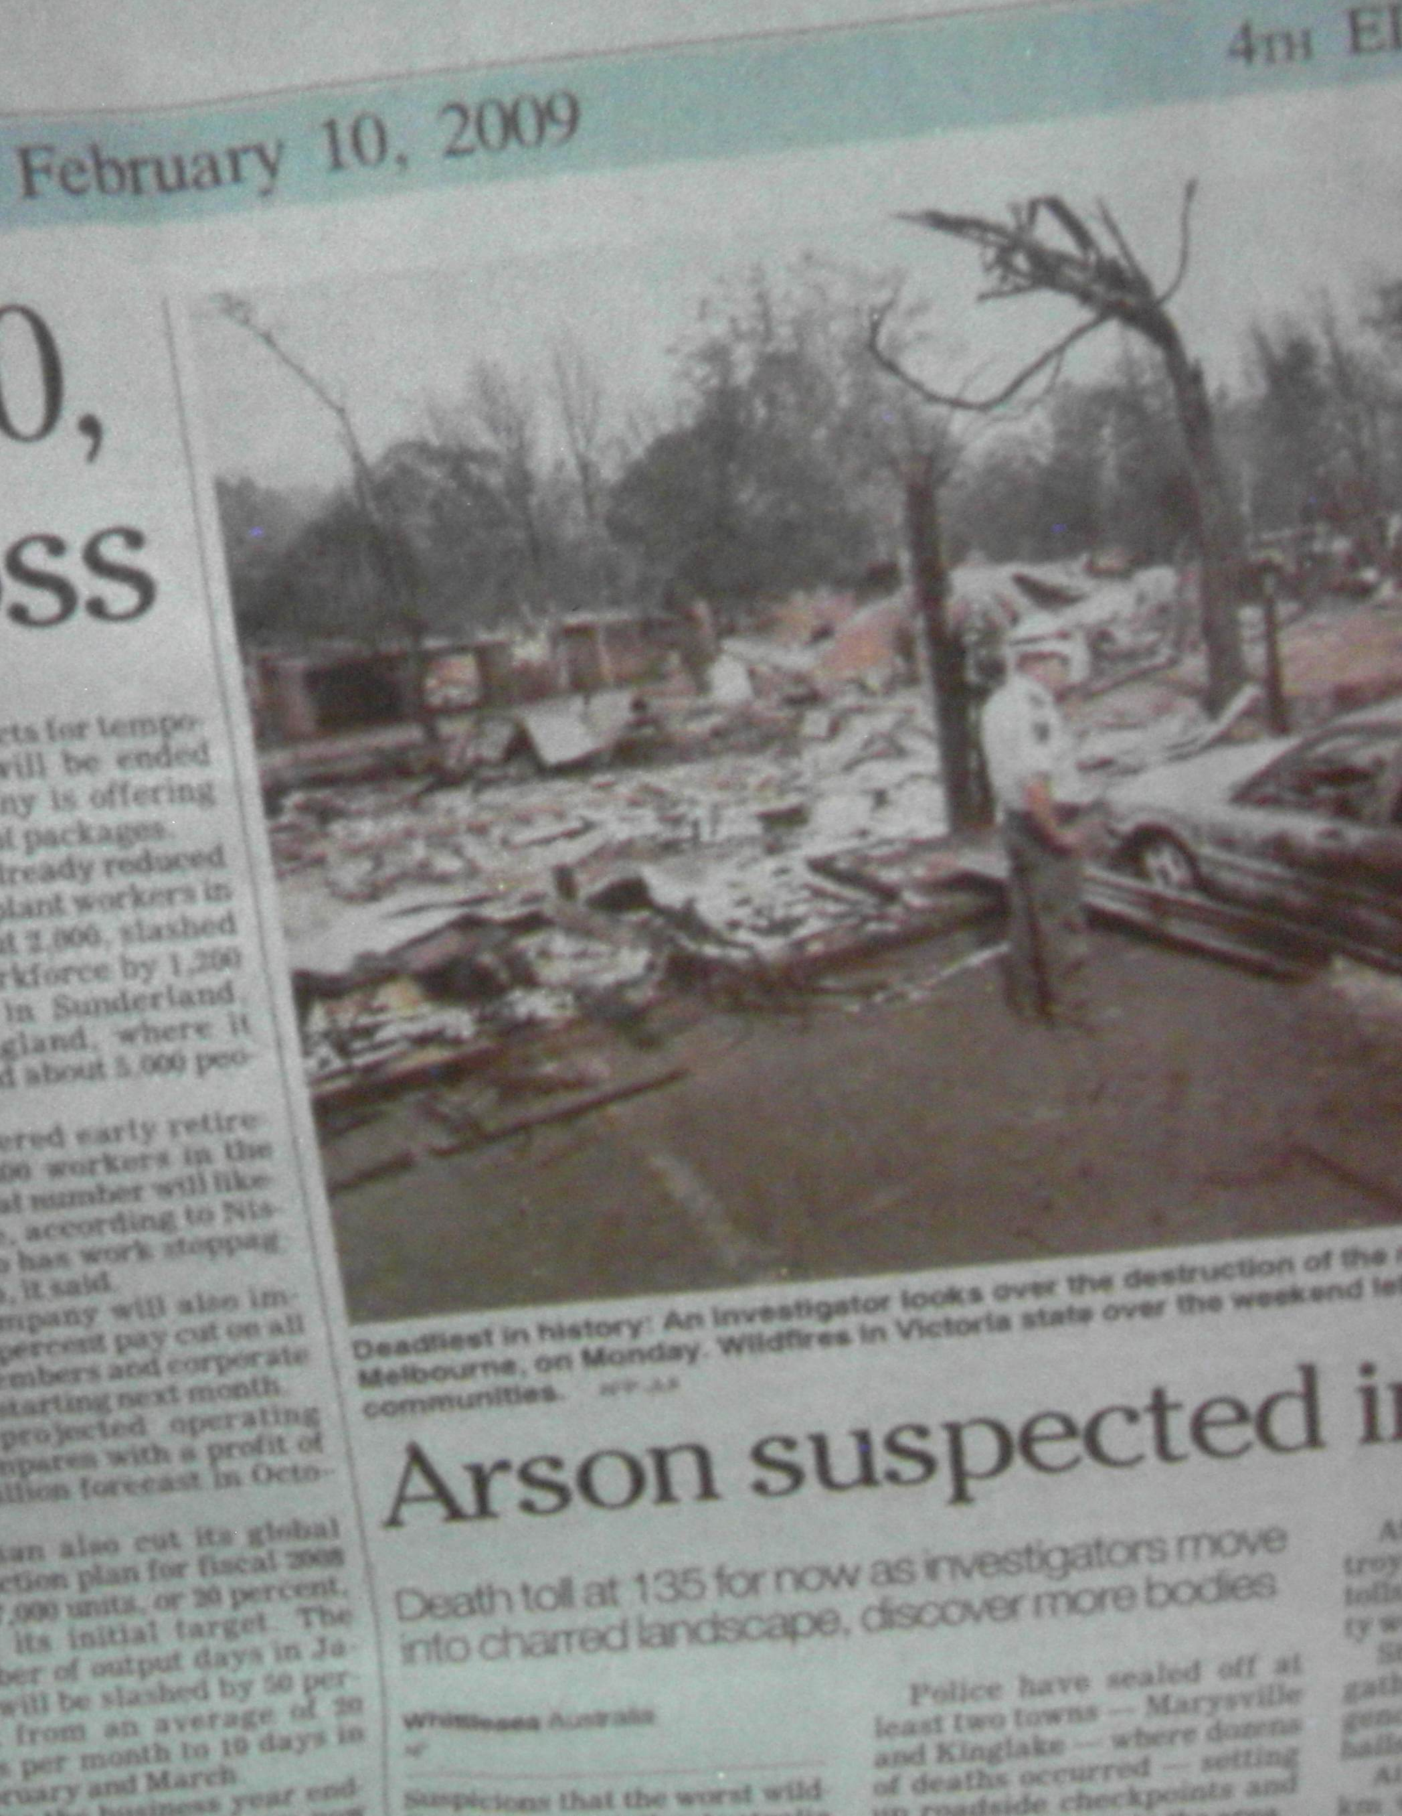

Collaboration Needs People and Data Sent Separately or at Very High Bandwidth (4K at 500Mb/s)

Slide 12
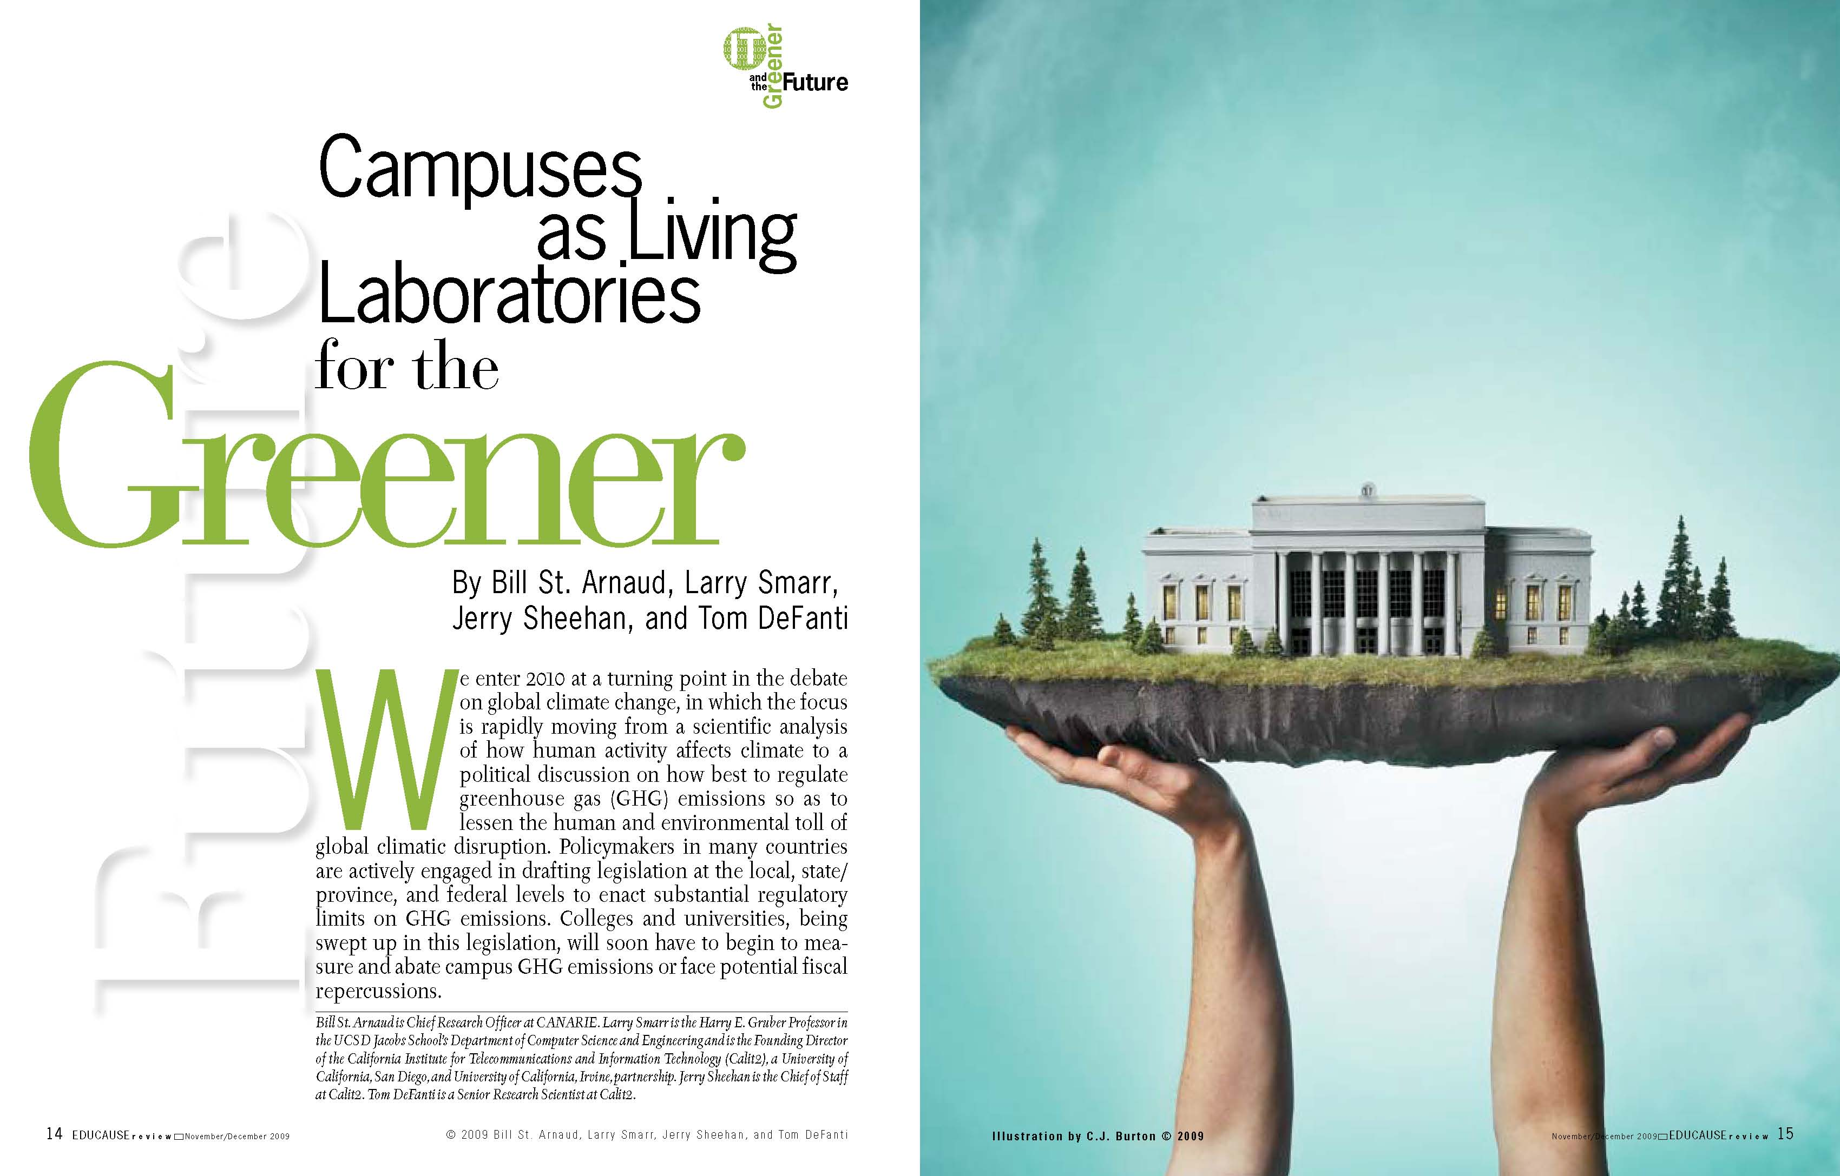
Larry Smarr will Green You Up at Dinner Tonight...
http://net.educause.edu/ir/library/pdf/ERM0960.pdf

Slide 13





Most US Universities Will Become Regulated Entities -- Emitting Over 25,000 Metric Tons CO₂e
Gross Emissions Scope 1 & 2 (CO₂e) | Year | US EPA GHG Rule Requires Reporting in 2011?
491,258 | 2008 | YES!
52,2709 | 2008 | YES!
80,498 | 2007 | YES!
234,000 | 2008 | YES!
309, 117 | 2008 | YES!
192,862 | 2008 | YES!
SOURCE: American College and University Presidents Climate Commitment, http://acupcc.aashe.org/

Slide 14
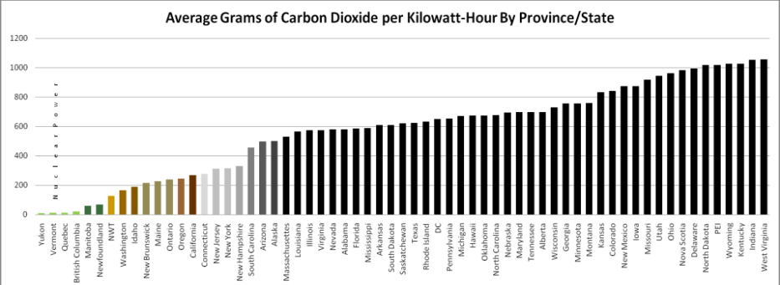
How Much Will Carbon Cap & Trade Cost Your Campus? Assume a 40MW Campus Like UCSD
Depends on How Carbon-Rich Your Electricity Production Is
88,000 mTCO₂e on California Campus
348,000 mTCO₂e on a Coal-Generated Electricity Campus
Assume that Carbon Trades at $20 per Metric Ton--the Cost to
A California Campus ~$1.8 Million/Year
Coal-Generated Power Campus ~$7 Million per Year
Indiana
CA

Slide 15
Additional Cap & Trade Cost to Servers
The EPA estimates that cap and trade will raise the cost of electricity for organizations by an “average” of 60%
Prices will be significantly higher in places dependent on coal powered electricity
Cap and trade will cost an organization at least an additional $65 -$150 per year per server (200W) if those servers are located in a coal-powered area instead of one that is powered by renewable energy such as hydro-electricity
Considering that most businesses and universities have thousands of servers, the aggregate bill could be gigantic
Dual Nvidia 295 GPU PCs consume 370W each when idle!
Source: www.thealders.net/blogs/2009/11/22/power-sources-and-their-coming-importance-to-your-business/

Slide 16

The UCSD NSF GreenLight Project

Slide 17
GreenLight’s Amin Vahdat Says:
Computing and storage will be delivered by a relatively small number of mega-scale data centers
Implications for current Internet architecture
Much of the activity will be around networking within and between data centers
Storage will be redesigned from the ground up
Query languages and models will be reinvented
To allow network fabric to keep up with end hosts, build a balanced system and reduce energy consumption
Scheduling algorithms to leverage path diversity
Dynamic energy management; Optics for energy-efficient networks
How do we find out what we need to know, as scientists and citizens?

Slide 18
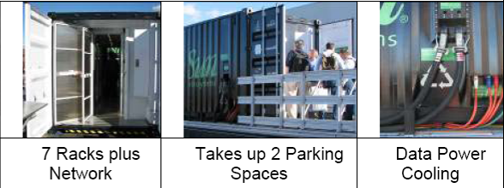


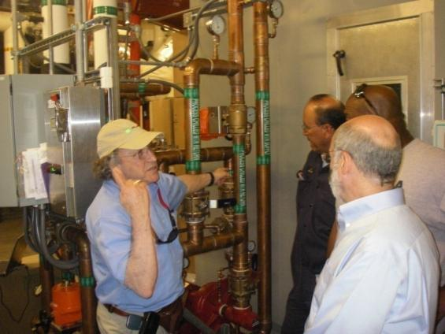

The NSF-Funded GreenLight Project Giving Users Energy-Known Compute and Storage Options
UCSD installed two Sun MDCs in 2008
GreenLight one is FULLY populated with PCs, FPGAs, GPGPUs, 250TB 10Gb/s disk, 5x10Gb/s networking to campus and GLIF via CENIC and NLR
$2M NSF-Funded GreenLight Project
Notes:
18

Slide 19
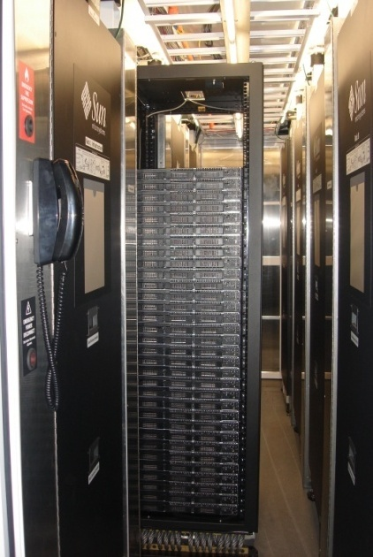
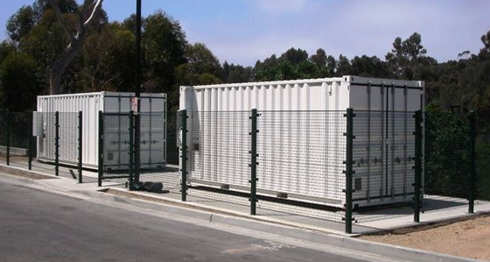
The GreenLight Project: Instrumenting the Energy Cost of Cluster Computing
Focus on 5 Communities with At-Scale Computing Needs:
Digital Media
Metagenomics
Ocean Observing
Microscopy
Bioinformatics
Goal: Measure, Monitor, & Web Publish Real-Time Sensor Outputs
Via Service-oriented Architectures with Rich Services
Allow Researchers Anywhere To Study Computing Energy Cost
Enable Scientists To Explore Tactics For Maximizing Work/Watt
Develop Middleware that Automates Optimal Choice of Compute/RAM Power Strategies for Desired Greenness
Use as Central Control for Campus Building Sensors
Notes:
19

Slide 20
What’s in the Box? Chris Misleh Reports:
Rack 1: Contains networking equipment.
Rack 2: 23 Nodes with two Intel Xeon E5440 Processors (2.83GHz) and 8GB memory (Compute nodes)
Rack 3: 7 nodes with two Intel E5430 Processors (2.66GHz) and 32GB memory (large memory nodes and 4 Nodes with two Intel Xeon E5440 Processors (2.83GHz) and 8GB memory (Compute nodes)
Rack 4: 6 GPGPU Nodes with dual Nvidia 295 cards, two Intel Xeon E5440 Processors (2.83GHz) , and 8GB memory and 4 Convey Nodes (FPGA nodes)
Rack 5: 5 Sunfire X4540 Storage Units, 48TB raw capacity each (Thumpers)
Rack 6: 6 GPGPU Nodes with dual Nvidia 295 graphics cards, two Intel Xeon E5440 Processors (2.83GHz), and 8GB memory.
Rack 7: 5 Sun Fire X4270 servers with two Intel Xeon X5570 Processors and 24GB memory (Nehalem compute nodes) and 6 Intel 2600 servers with two Intel Xeon X5550 Processors and 24GB memory (Nehalem compute nodes)
Rack 8: DC Power equipment, transformer, rectifier and DC control
Switches: Each rack contains two Extreme Networks Summit X350-48ts switches. 10Gb OptIPuter network connectivity is available via a Fujitsu XG2000 switch.
PDU/Monitoring: Each rack contains Avocent PM3024 PDUs with per port power monitoring: Intermapper Monitoring, IPMI Monitoring, DSView3 Monitoring

Slide 21
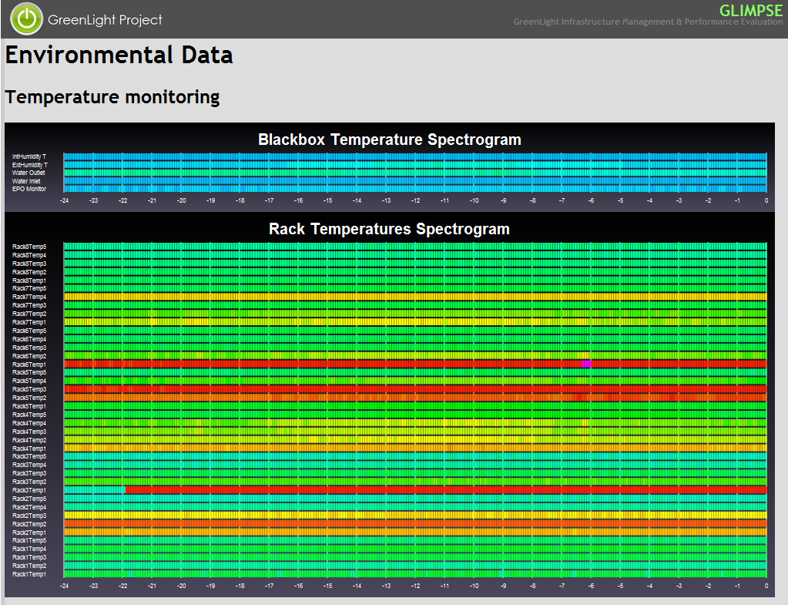
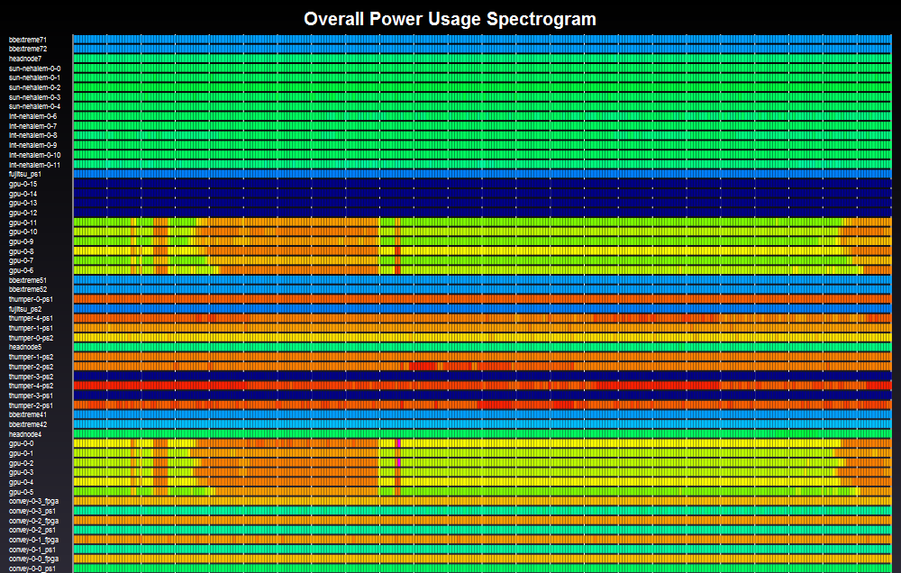
GreenLight Spectrograms Ingolf Krueger, Claudiu Farcas, Filippo Seracini
High power consumption on GPGPU nodes.
High temperature in Rack #5

Slide 22
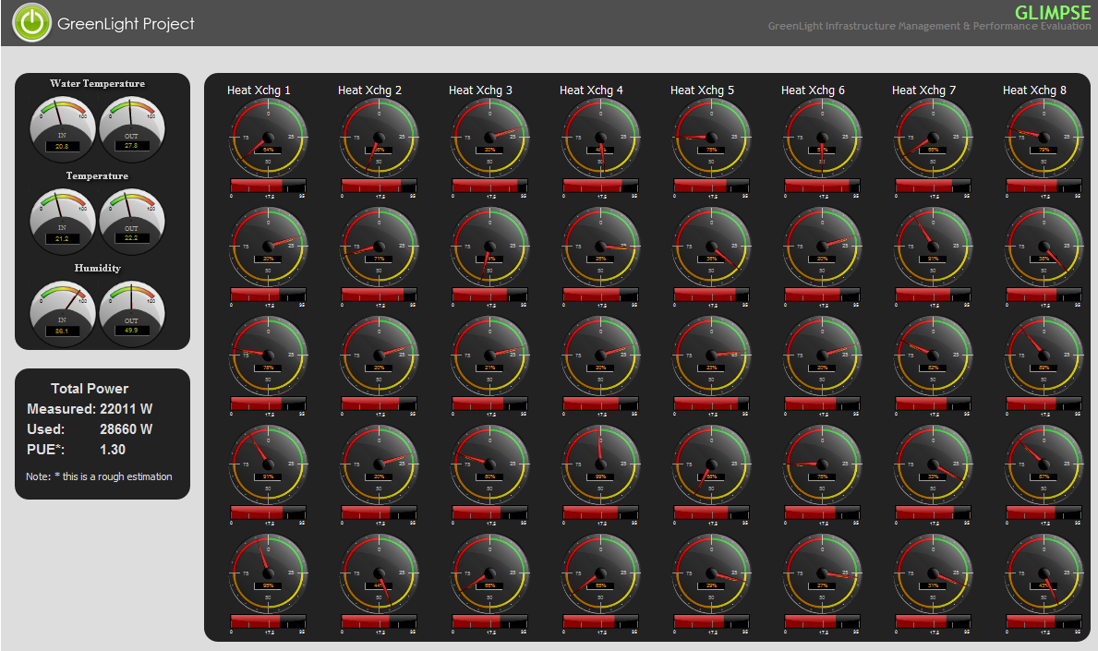
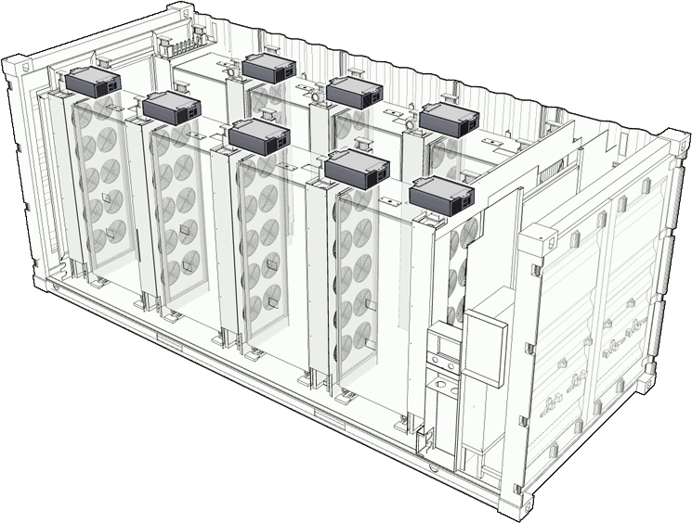
GreenLight Dashboard: Ingolf Krueger, Claudiu Farcas, Filippo Seracini
Environmental Data
HOT!
FAST!
Campus vs Instrumented
28Kw*2=$56/hr
$40K/month
Power usage effectiveness (PUE) is a measure of how efficient a computer data center uses its power

Slide 23
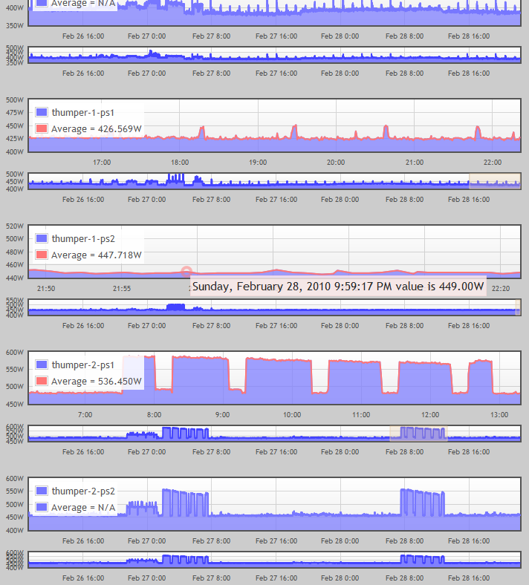
Time Range/Zoom Ingolf Krueger, Claudiu Farcas, Filippo Seracini
History over several days.
Zoom on desired time range.
Hint on each sample point.
Automatic average area.
Multiple sensors per asset with up to 1 min sampling resolution.

Slide 24
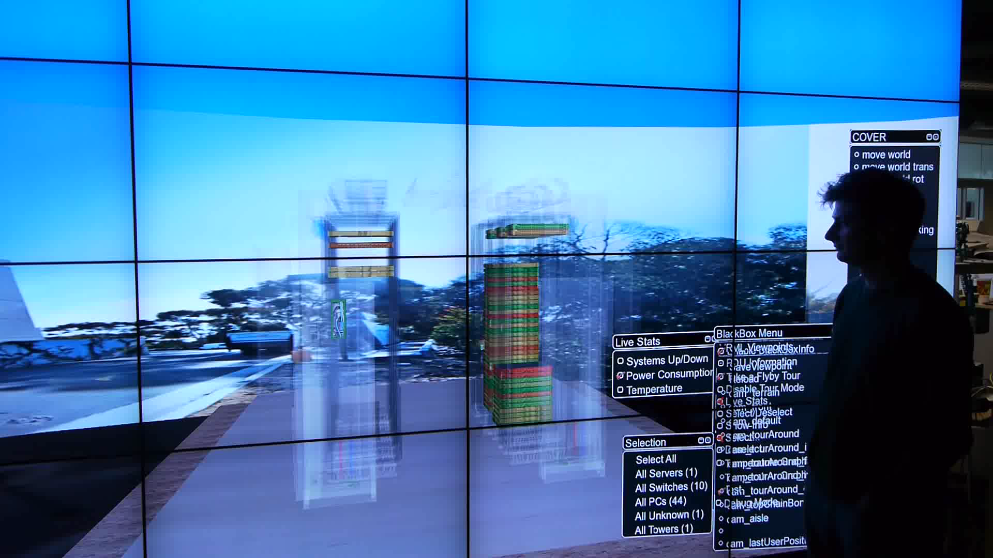
GreenLight: Walk-In Monitoring Jurgen Schulze, Seth Rotkin, Mabel Zhang, Philip Weber

Slide 25
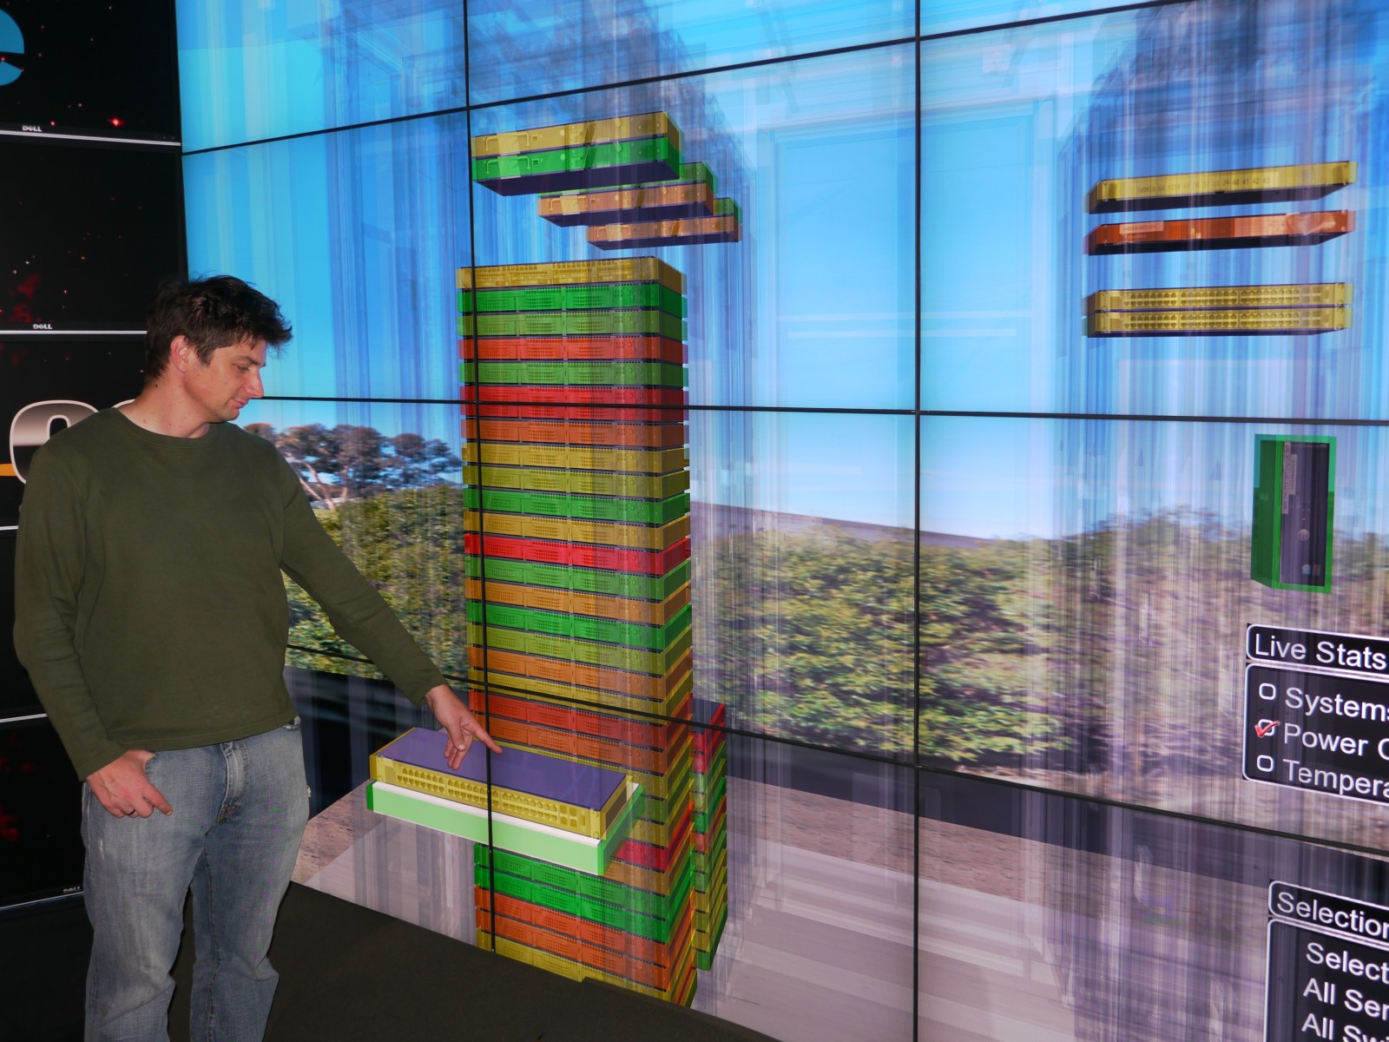
AESOP ~4800W/hr 12 tiles Power Utilization Measured by GreenLight at Calit2
(includes displays, PCs+head node, coordinating 10G switch)
Double for cooling, so ~10/hr to run at 10 cents/kWh
(about $2,400/month 8 hours a day=1 Grad Student (-1 cent/hr for cooling))

Slide 26

Quaternions on GPGPUs
Raj Singh – National Center for Microscopy and Imaging Research
Daniel J. Sandin - Electronic Visualization Laboratory, UIC

Slide 27









Quaternions –Benchmarking Parallel Computing Architectures
Computationally intensive rendering
Each pixel is rendered iteratively
Rendering one 4K frame takes 10-20 minutes on a single CPU.
Rendering a ~5000 frame animation sequence takes almost 25 days.
Embarrassingly parallel at the pixel level
Low I/O overhead
Low Memory bandwidth requirements
Visual output helps confirm correctness

Slide 28
Speedups (CPU cluster v/s GPU cluster)
46.3 X
42.5 X
20.4 X
Run times of a 4700 frame animation (in secs)
True speed-up of one GPU is ~100X and true speed-up of the entire cluster is > 4000X
Results were stored on local scratch disk because NFS overhead was significant.
GreenLight GPGPU Experiments—Raj Singh and Dan Sandin

Slide 29
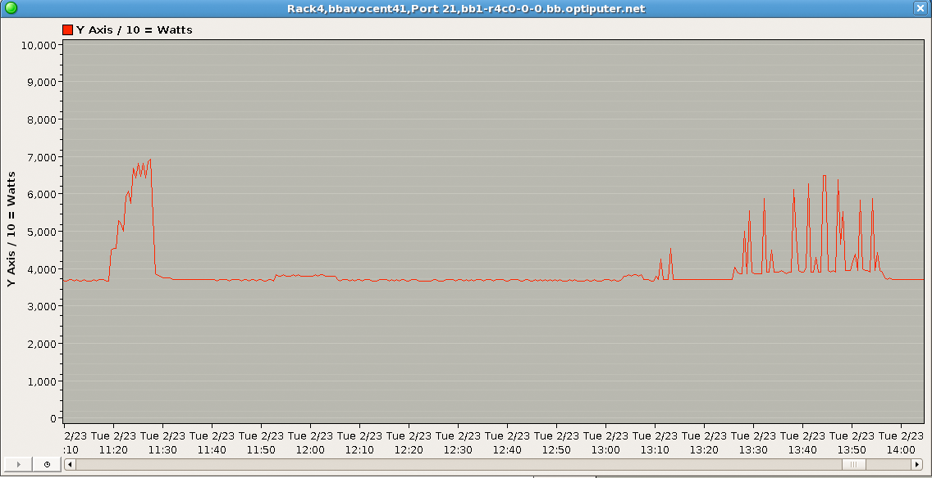
NFS problems
GPU run with results on local scratch
GPU run with results on NFS
NFS was a bottleneck for GPU version of the code. Added up to an hour and a half to runtimes
GreenLight GPGPU Experiments—Raj Singh and Dan Sandin

Slide 30
Power Consumption
Power in Watts for all 12 nodes of the cluster
GreenLight GPGPU Experiments—Raj Singh and Dan Sandin

Slide 31
Energy consumption
35.27 X
32.56 X
15.6 X
Energy consumed by 12 nodes (in KWh)
GreenLight GPGPU Experiments—Raj Singh and Dan Sandin

Slide 32
GreenLight: School of Medicine TB Tests: Trey Ideker and Chris Misleh
DNA Sequencers produce 1TB of data/week. Storage is the limiting factor.
There are many factors such as dataset composition, protocol, physical limitation of the storage server, and networking that can affect power usage.
Data begins on a Sunfire X4540 Thumper, flows to a Fujitsu XG2000 10Gb switch, then to a Force 10 E1200, and then to another Sunfire X4540.
One storage unit mounted the other via NFS and a “cp” command was executed to transfer data. Over 200K files transferred per run.
Test 1: UDP From the GreenLight Box to Calit2
Test 2: TCP From the GreenLight Box to Calit2
Results: UDP was almost twice as fast as TCP in this transfer. Power needed for UDP test was very close to power for the TCP test.
Sun Thumpers used 953W + 964W (one each end)
Fujitsu TCP/UDP constant 112W
Force10 E1200 2585W constant (23x the smaller switch)
Total 4614W for 6h30m/10h50m hrs. Approx. $3.00 or $5.00 at 10 cents/kwh
Double that if cooling is counted in. Add total cost of ownership?
Other questions worth a GreenLight test run? See me later!

Slide 33
Another Example: Improve Mass Spectrometry’s Green Efficiency By Matching Algorithms to Specialized Processors
Inspect application implements the very computationally intense Mass Spectrometry Alignment algorithm for discovery of unanticipated rare or uncharacterized Post-Translational Modifications
Solution: Hardware acceleration with FPGA-based co-Processors (Convey)
Results:
300x Speedup with hand FPGA coding
What increase in work/watt
What increase in work/$ (purchase, life-cycle)?
Stay tuned!

Slide 34
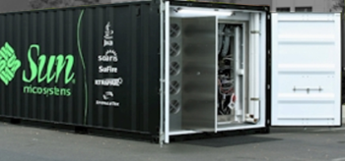











Machine Learning for Dynamic Power and Thermal Management to Reduce Energy Requirements
NSF Project GreenLight
Green Cyberinfrastructure in Energy-Efficient Modular Facilities
Closed-Loop Power &Thermal Management
Dynamic Power Management (DPM)
Dynamic Thermal Management (DTM)
Optimal DPM for a Class of Workloads
Machine Learning to Adapt
Select Among Specialized Policies
Use Sensors and Performance Counters to Monitor Multitasking/Within Task Adaptation of Voltage and Frequency
Measured Energy Savings of Up to 70% per Device
Workload Scheduling
Machine learning for Dynamic Adaptation to get Best Temporal and Spatial Profiles with Closed-Loop Sensing
Proactive Thermal Management
Reduces Thermal Hot Spots by Average 60% with No Performance Overhead
CNS
System Energy Efficiency Lab (seelab.ucsd.edu)
Prof. Tajana Šimunić Rosing, CSE, UCSD

Slide 35
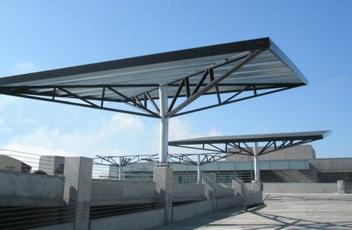
GreenLight Experiment: Direct 400v DC-Powered Modular Data Center
Concept—Avoid DC to AC to DC Conversion Losses
Computers use DC power internally
Solar and fuel cells produce DC
Both plug into the AC power grid
Can we use DC directly?
Scalable/Distributable?
DC Generation Can Be Intermittent
Depends on source
Solar, Wind, Fuel Cell, Hydro
Can use sensors to shut down or sleep computers
Can use virtualization to halt/shift Jobs
Can switch to AC as backup
UCSD DC Fuel Cell 2800kW
Sun MDC <100-200kW
2 Megawatts of Solar Power Cells Being Installed
Notes:
35

Slide 36

To be Energy Efficient, We Must Think about Koala-Style Computing and other “Smart” Ways
Size Your Brain Power, Visualization, Storage, Sleep Cycles, and Communications to Your Problem
Next Step:
Get more terabytes/watt!

Slide 37
GreenLight Extended to Networks
The GreenLight switches: accurate measurement of the cost of campus-scale network transmission of data between servers
6x10Gb of cross-campus DWDM—can go to 10x10Gb easily
Cisco 6509, Force10, Extreme, Glimmerglass, and Arista switches
Ethernet-connected power distribution units (PDUs) supply fine-grained energy measurements
Combine with bandwidth statistics on per link basis: local watts/TB
WAN terrestrial and undersea transmission costs in long-distance watts/TB
more complex: measuring off campus involves access to production equipment administered by many entities
Uniquely, Calit2/SDSC//NLR/CENIC/StarLight/PNWGP/NetherLight, etc. have software and hardware access to long-distance transmission equipment
Physically at UCSD, 1 Wilshire, PNWGP, StarLight and NetherLight (namely Cisco 15454s and Nortel OME/HDXcs)
CENIC and I-WIRE control the repeater huts so we can also find out the watts/lambda needed for signal regeneration.
For undersea circuits, the NSF/UCSD OOI initiative will calibrate and measure the energy costs for underwater equipment prior to it being placed in the ocean.
Compare notes with our leased transatlantic circuit suppliers and friends

Slide 38
GreenLight Extended to Networks
An additional green and transformative use is high-definition and 4K videoconferencing with SAGE, CSCW software.
Now called dematerialization by the ICT industry
Intense international interest because physical travel to overseas meetings is expensive (particularly in GHGs), time consuming, and less productive in general
Cloud computing may provide 10-20x efficiency through
Virtualization and software optimizations
Much better total life-cycle cost management than universities or typical corporate centers
Powering of servers in more carbon-neutral facilities
Amazon EC2 (now in service for OOI)
Discussions with Microsoft show great interest in soon providing cloud-computing to TransLight to improve the global availability of their science-serving distributed facilities.
Of course, the best GHG-reducing applications are no doubt yet to be thought up and tested.
I would like to discuss these ideas with people here at PRAGMA.

Slide 39
Thank You PRAGMA!
Our planning, research, and education efforts are made possible, in major part, by funding and donations from:
KAUST
US National Science Foundation (NSF) awards ANI-0225642, EIA-0115809, SCI-0441094, and CNS 0821155
State of California, Calit2 UCSD Division
NTT Network Innovations Lab
Cisco Systems, Inc.
Pacific Interface, Inc.
Darkstrand, Inc.
Sharp Labs of America
Intel
And networking from:
National Lambda Rail, Pacific Wave, CENIC, and I-WIRE
University of Illinois at Chicago and Argonne National Laboratory
Northwestern University for StarLight networking and management
Notes:
39

